Slide 1
Detection And Classification Of Incipient Faults In Automotive Using Machine Learning Approach
Peculiar_Panch
Binny Mathew
Jay Thakkar
Md Fraz Ansari
Bhushan Naware

Slide 2
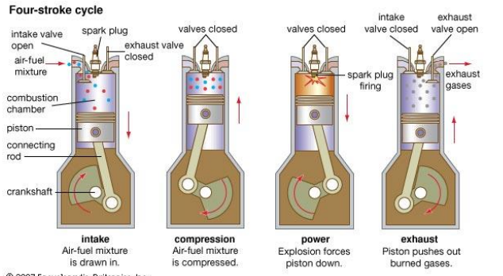
Problem Definition
Online fault diagnosis of automotive engines is a crucial part of integrated vehicle health management (IVHM) and associated prognosis strategies, which are being employed in increasingly many automotive vehicles at present times.
Detection of early and low magnitude faults in automotive engines requires dynamic engine models which can capture within-cycle continuous switching dynamics of engine under different input and state conditions.
Because implementations of such accurate model based diagnosis schemes require huge computational capacity usually not found on engine electronic control units (ECUs), a trade-off is sought between model complexity and performance of diagnosis schemes.
We are targeting here the training of data and interpretation of faults on the earlier work done and trying to explore the machine learning opportunities in the context of fault detection.

Slide 3
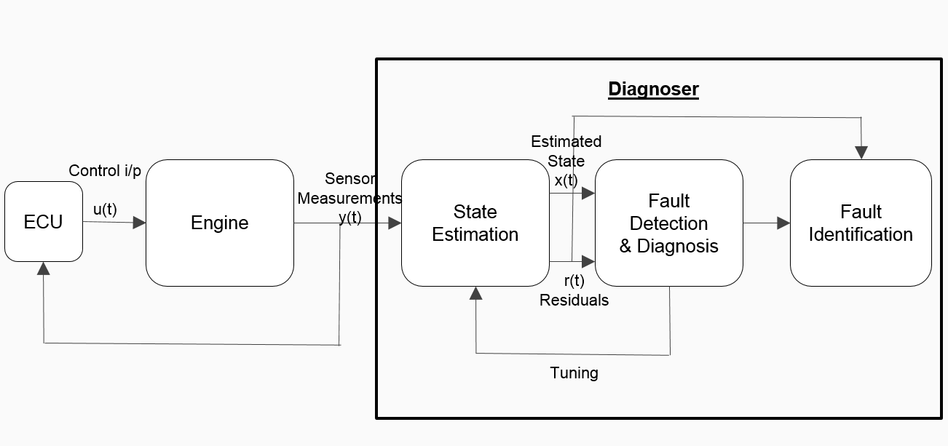
Methodology
We make use of the training data obtained from sensors and actuators connected to TATA NANO car in NP-MASS lab.
Also the other estimated data is from the mathematical Simulink model.
Using these two reference data and residual; we take it as the main data set for training.
On the training data from plant (Live Tata Nano care) and Matlab Simulink model, we run ML algorithms to check for the fault detection.
We used Random forest Algorithm as our main algorithm of choice.
Figure: Introduction to the work, block diagram
ML Algorithm (Random Forest etc.)
Training Data
Output
Schematic representation of operation on training data and output.

Slide 4
Results
 | Precision | Recall | F-Measure | ROC Area | Class
 | 0.961 | 0.98 | 0.97 | 0.999 | 0
 | 0.96 | 0.967 | 0.963 | 0.995 | 1
 | 0.959 | 0.947 | 0.953 | 0.995 | 2
 | 0.993 | 0.98 | 0.987 | 1 | 3
Weighted Avg | 0.968 | 0.968 | 0.968 | 0.997
 | Precision | Recall | F-Measure | ROC Area | Class
 | 0.814 | 0.834 | 0.824 | 0.903 | 0
 | 0.767 | 0.816 | 0.791 | 0.896 | 1
 | 0.741 | 0.738 | 0.739 | 0.849 | 2
 | 0.904 | 0.828 | 0.864 | 0.907 | 3
Weighted Avg. | 0.807 | 0.804 | 0.805 | 0.889
 | Precision | Recall | F-Measure | ROC Area | Class
 | 0.946 | 0.94 | 0.943 | 0.965 | 0
 | 0.9 | 0.72 | 0.8 | 0.929 | 1
 | 0.732 | 0.927 | 0.818 | 0.926 | 2
 | 0.957 | 0.9 | 0.928 | 0.955 | 3
Weighted Avg. | 0.884 | 0.872 | 0.872 | 0.944

Slide 5
Conclusion

Slide 6
Thank You

Slide 7
Backup

Slide 8
Existing Methods and Corresponding Performance
Existing approach vary with what kind of faults are to be detected. There exists an entire ecosystem of fault diagnosis depending on the industry , application and other subtle intricacies.
Here we are enlisting some of the existing methods purely w.r.t vehicular fault detection.
For the existing training data we are referring to the work done in NP-MASS lab in EE engineering as preliminary reference.
S.No | Fault | Methods
1 | Fuel System Faults | ANN , Fuzzy Based, Model Based
2 | Misfire detection | Threshold Checking
3 | Knock Monitoring | Time-Frequency Analysis, Fourier based

Slide 9
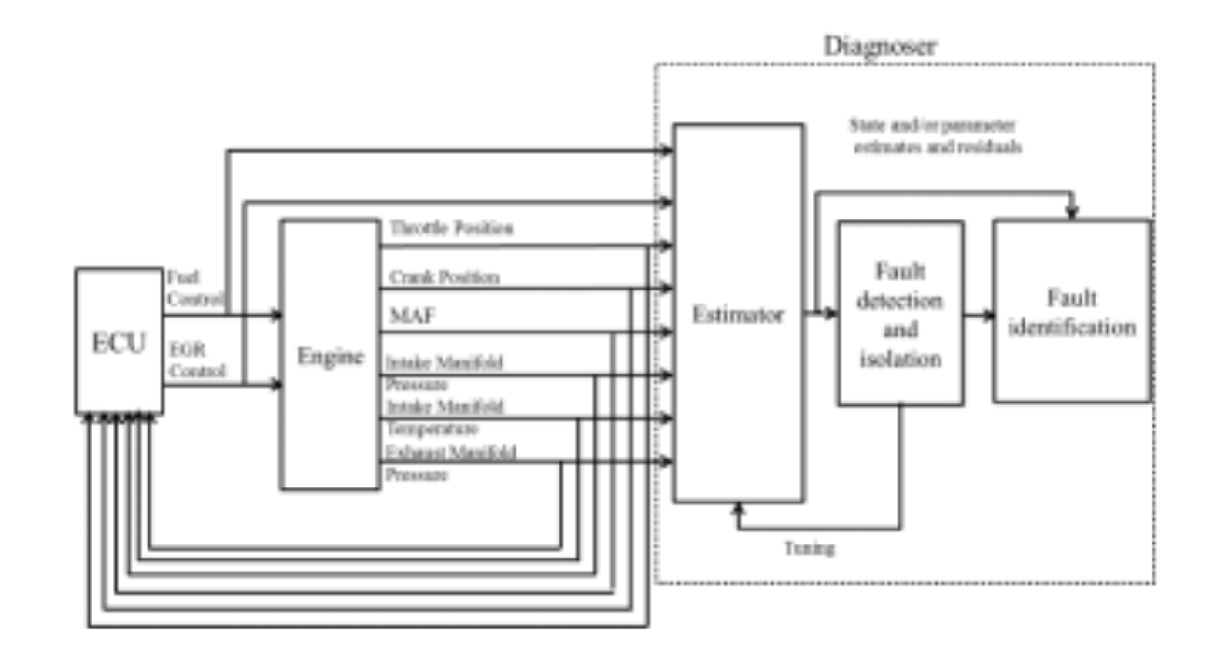
Methods to be Implemented (i)
Existing methodology in the NP-MASS lab for fault detection on TATA Nano

Slide 10
Methods to be Implemented (ii)
A (E+ML)
B
(ML SA)
What we Intend to Do over the course of this project .

Slide 11
Data Set : Elaboration
Data set consists.
Temperature Sensor
Pressure Sensor
Throttle
Crank angle
Vehicle speed et.al

Slide 12
Roadmap & Progress
Problem Identification
Literature Survey
Approach to be used
Implementation of ML Technique
Performance comparison
Standalone & Hybrid Variants (Refer previous slide)
Conclusion

